Slide 1
Arhitecturi Paralele MPI
Prof. Florin Pop
As. Drd. Ing. Cristian Chilipirea
cristian.chilipirea@cs.pub.ro
Elemente preluate din cursul Prof. Ciprian Dobre

Slide 3
Installing OpenMPI
apt-get install libopenmpi-dev openmpi-bin openmpi-doc openmpi-common

Slide 4
Compiling and running MPI programs
mpicc test.c
mpirun –np 4 a.out
mpirun –np 3 date
./a.out
Starts 4 processes.
Possibly on different machines.
They are identical but have different ids.
Works with non-MPI programs.
Works but starts only one process.

Slide 5
MPI example
#include<mpi.h>
#include<stdio.h>
int main(int argc, char * argv[])
{
int rank;
int nProcesses;
MPI_Init(&argc, &argv);
MPI_Comm_rank(MPI_COMM_WORLD, &rank);
MPI_Comm_size(MPI_COMM_WORLD, &nProcesses);
printf("Hello from %i/%i\n", rank, nProcesses);
MPI_Finalize();
return 0;
}

Slide 6
MPI example
#include<mpi.h>
#include<stdio.h>
int main(int argc, char * argv[])
{
int rank;
int nProcesses;
MPI_Init(&argc, &argv);
MPI_Comm_rank(MPI_COMM_WORLD, &rank);
MPI_Comm_size(MPI_COMM_WORLD, &nProcesses);
printf("Hello from %i/%i\n", rank, nProcesses);
MPI_Finalize();
return 0;
}
Start MPI Process

Slide 7
MPI example
#include<mpi.h>
#include<stdio.h>
int main(int argc, char * argv[])
{
int rank;
int nProcesses;
MPI_Init(&argc, &argv);
MPI_Comm_rank(MPI_COMM_WORLD, &rank);
MPI_Comm_size(MPI_COMM_WORLD, &nProcesses);
printf("Hello from %i/%i\n", rank, nProcesses);
MPI_Finalize();
return 0;
}
Get the id (rank)

Slide 8
MPI example
#include<mpi.h>
#include<stdio.h>
int main(int argc, char * argv[])
{
int rank;
int nProcesses;
MPI_Init(&argc, &argv);
MPI_Comm_rank(MPI_COMM_WORLD, &rank);
MPI_Comm_size(MPI_COMM_WORLD, &nProcesses);
printf("Hello from %i/%i\n", rank, nProcesses);
MPI_Finalize();
return 0;
}
Get the total number of processed

Slide 9
MPI example
#include<mpi.h>
#include<stdio.h>
int main(int argc, char * argv[])
{
int rank;
int nProcesses;
MPI_Init(&argc, &argv);
MPI_Comm_rank(MPI_COMM_WORLD, &rank);
MPI_Comm_size(MPI_COMM_WORLD, &nProcesses);
printf("Hello from %i/%i\n", rank, nProcesses);
MPI_Finalize();
return 0;
}
Print hello from all processes.

Slide 10
MPI example
#include<mpi.h>
#include<stdio.h>
int main(int argc, char * argv[])
{
int rank;
int nProcesses;
MPI_Init(&argc, &argv);
MPI_Comm_rank(MPI_COMM_WORLD, &rank);
MPI_Comm_size(MPI_COMM_WORLD, &nProcesses);
printf("Hello from %i/%i\n", rank, nProcesses);
MPI_Finalize();
return 0;
}
Stop the MPI environment.

Slide 11
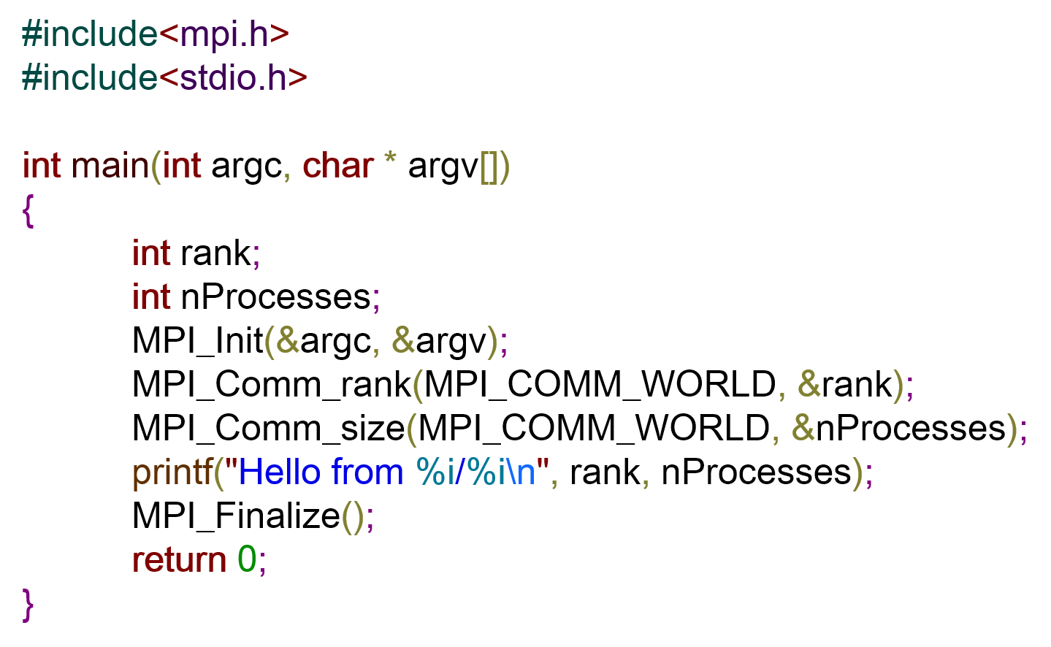
MPI example executed
Hello from 0/4
Hello from 3/4
Hello from 2/4
Hello from 1/4

Slide 12
MPI memory
Nu avem memorie partajată în MPI
Toate variabilele sunt locale proceselor.
Pentru a muta informație de la un proces la altul vor trebui folosite funcții explicite.
Send/Recv
Broadcast
Scatter
Gather

Slide 14
MPI_Send/MPI_Recv
int MPI_Send( ↓ void *b, ↓ int c, ↓ MPI_Datatype d, ↓ int reiceiver, ↓ int t, ↓ MPI_Comm)
v
&v[3]
&a
v+5
num_el(v)
[0,..)
MPI_INT
MPI_CHAR
MPI_FLOAT
MPI_LONG
MPI_COMM_WORLD
[ 0, num_tasks )
[ 0, .. )

Slide 15
MPI_Send/MPI_Recv
int MPI_Recv( ↑ void *b, ↓ int c, ↓ MPI_Datatype d, ↓ int sender, ↓ int t, ↓ MPI_Comm, ↑ MPI_Status * )
v
&v[3]
&a
v+5
MPI_INT
MPI_CHAR
MPI_FLOAT
MPI_LONG
[ 0, .. )
MPI_ANY_TAG
[ 0, num_tasks )
MPI_ANY_SOURCE
num_el(v)
[0,..)
MPI_COMM_WORLD
&Stat
MPI_STATUS_IGNORE
Stat.MPI_SOURCE, Stat.MPI_TAG

Slide 16
MPI_Bcast
int MPI_Bcast ( ↕ void *b, ↓ int c, ↓ MPI_Datatype d, ↓ int root, ↓ MPI_Comm )
v
&v[3]
&a
v+5
num_el(v)
[0,..)
[ 0, num_tasks )
MPI_INT
MPI_CHAR
MPI_FLOAT
MPI_LONG
MPI_COMM_WORLD

Slide 17
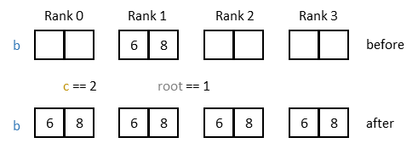
MPI_Bcast

Slide 18
MPI_Scatter
int MPI_Scatter ( ↓ void *sb, ↓ int sc, ↓ MPI_Datatype sd, ↑ void *rb, ↓ int rc, ↓ MPI_Datatype rd, ↓ int root, ↓ MPI_Comm )
v
&v[3]
&a
v+5
v
&v[3]
&a
v+5
[ 0, num_tasks )
num_el(v)/num_tasks
[0,..)
num_el(v)/num_tasks
[0,..)
MPI_COMM_WORLD
MPI_INT
MPI_CHAR
MPI_FLOAT
MPI_LONG
MPI_INT
MPI_CHAR
MPI_FLOAT
MPI_LONG

Slide 19
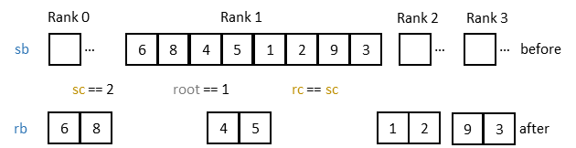
MPI_Scatter

Slide 20
MPI_Gather
int MPI_Gather ( ↓ void *sb, ↓ int sc, ↓ MPI_Datatype sd, ↑ void *rb, ↓ int rc, ↓ MPI_Datatype rd, ↓ int root, ↓ MPI_Comm )
v
&v[3]
&a
v+5
v
&v[3]
&a
v+5
num_el(v)/num_tasks
[0,..)
[ 0, num_tasks )
num_el(v)/num_tasks
[0,..)
MPI_INT
MPI_CHAR
MPI_FLOAT
MPI_LONG
MPI_INT
MPI_CHAR
MPI_FLOAT
MPI_LONG
MPI_COMM_WORLD

Slide 21
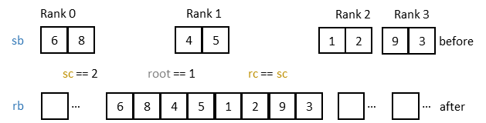
MPI_Gather

Slide 23
MPI blocking/non-blocking send/recv
Process 1
Process 2
MPI_Send()
MPI_Recv()

Slide 24
MPI blocking/non-blocking send/recv
Process 1
Process 2
MPI_Send()
MPI_Recv()
MPI/Kernel Buffer
MPI/Kernel Buffer
Network

Slide 25
MPI blocking recv/non-blocking send
Process 1
Process 2
Program counter
MPI_Send()
MPI_Recv()
MPI/Kernel Buffer
MPI/Kernel Buffer
Network

Slide 26

MPI blocking recv/non-blocking send
Process 1
Process 2
MPI_Send()
MPI_Recv()
MPI/Kernel Buffer
MPI/Kernel Buffer
Network

Slide 27
MPI blocking recv/non-blocking send
Process 1
Process 2
MPI_Send()
MPI_Recv()
MPI/Kernel Buffer
MPI/Kernel Buffer
Network

Slide 28
MPI blocking recv/non-blocking send
Process 1
Process 2
MPI_Send()
MPI_Recv()
MPI/Kernel Buffer
MPI/Kernel Buffer
Network

Slide 29
MPI blocking recv/non-blocking send
Process 1
Process 2
MPI_Send()
MPI_Recv()
MPI/Kernel Buffer
MPI/Kernel Buffer
Network

Slide 30
MPI blocking recv/non-blocking send
Process 1
Process 2
MPI_Send()
MPI_Recv()
MPI/Kernel Buffer
MPI/Kernel Buffer
Network

Slide 31
MPI blocking recv/non-blocking send
Process 1
Process 2
MPI_Send()
MPI_Recv()
MPI/Kernel Buffer
MPI/Kernel Buffer
Network

Slide 32
MPI blocking recv/blocking send
Process 1
Process 2
MPI_Send()
MPI_Send() can block if the local buffer is full
MPI/Kernel Buffer
Network

Slide 33
MPI blocking recv/blocking send
Process 1
Process 2
MPI_Send()
MPI_Recv()
MPI/Kernel Buffer
MPI/Kernel Buffer
Network

Slide 34
MPI blocking recv/blocking send
Process 1
Process 2
MPI_Send()
MPI_Recv()
MPI/Kernel Buffer
MPI/Kernel Buffer
Network

Slide 35
MPI blocking recv/synchronized send

Slide 36
MPI blocking recv/synchronized send
Process 1
Process 2
MPI_Ssend()
MPI_Recv()
MPI/Kernel Buffer
MPI/Kernel Buffer
Network

Slide 37
MPI blocking recv/synchronized send
Process 1
Process 2
MPI_Ssend()
MPI_Recv()
MPI/Kernel Buffer
MPI/Kernel Buffer
Network

Slide 38
MPI blocking recv/synchronized send
Process 1
Process 2
MPI_Ssend()
MPI_Recv()
MPI/Kernel Buffer
MPI/Kernel Buffer
Network

Slide 39
MPI blocking recv/synchronized send
Process 1
Process 2
MPI_Ssend()
MPI_Recv()
MPI/Kernel Buffer
MPI/Kernel Buffer
Network

Slide 40
MPI blocking recv/synchronized send
Process 1
Process 2
MPI_Ssend()
MPI_Recv()
MPI/Kernel Buffer
MPI/Kernel Buffer
Network

Slide 41
MPI blocking recv/synchronized send
Process 1
Process 2
MPI_Ssend()
MPI_Recv()
Got it!
MPI/Kernel Buffer
MPI/Kernel Buffer
Network

Slide 42
MPI blocking recv/synchronized send
Process 1
Process 2
MPI_Ssend()
MPI_Recv()
MPI/Kernel Buffer
MPI/Kernel Buffer
Got it!
Network

Slide 43
MPI blocking recv/synchronized send
Process 1
Process 2
MPI_Ssend()
MPI_Recv()
MPI/Kernel Buffer
MPI/Kernel Buffer
Got it!
Network

Slide 44
MPI blocking recv/synchronized send
Process 1
Process 2
MPI_Ssend()
MPI_Recv()
Got it!
MPI/Kernel Buffer
MPI/Kernel Buffer
Network

Slide 45
MPI blocking recv/synchronized send
Process 1
Process 2
Got it!
MPI_Ssend()
MPI_Recv()
MPI/Kernel Buffer
MPI/Kernel Buffer
Network

Slide 46
MPI non-blocking recv/non-blocking send

Slide 47
MPI non-blocking recv/non-blocking send
Process 1
Process 2
MPI_Test()
returns
0
MPI_Test()
returns
0
MPI_Isend()
MPI_Irecv()
MPI/Kernel Buffer
MPI/Kernel Buffer
Network

Slide 48
MPI non-blocking recv/non-blocking send
Process 1
Process 2
MPI_Test()
returns
0
MPI_Test()
returns
0
MPI_Isend()
MPI_Irecv()
MPI/Kernel Buffer
MPI/Kernel Buffer
Network

Slide 49
MPI non-blocking recv/non-blocking send
Process 1
Process 2
MPI_Test()
returns
1
MPI_Test()
returns
0
MPI_Isend()
MPI_Irecv()
MPI/Kernel Buffer
MPI/Kernel Buffer
Network

Slide 50
MPI non-blocking recv/non-blocking send
Process 1
Process 2
MPI_Test()
returns
1
MPI_Test()
returns
0
MPI_Isend()
MPI_Irecv()
MPI/Kernel Buffer
MPI/Kernel Buffer
Network

Slide 51
MPI non-blocking recv/non-blocking send
Process 1
Process 2
MPI_Test()
returns
1
MPI_Test()
returns
0
MPI_Isend()
MPI_Irecv()
MPI/Kernel Buffer
MPI/Kernel Buffer
Network

Slide 52
MPI non-blocking recv/non-blocking send
Process 1
Process 2
MPI_Test()
returns
1
MPI_Test()
returns
1
MPI_Isend()
MPI_Irecv()
MPI/Kernel Buffer
MPI/Kernel Buffer
Network

Slide 54
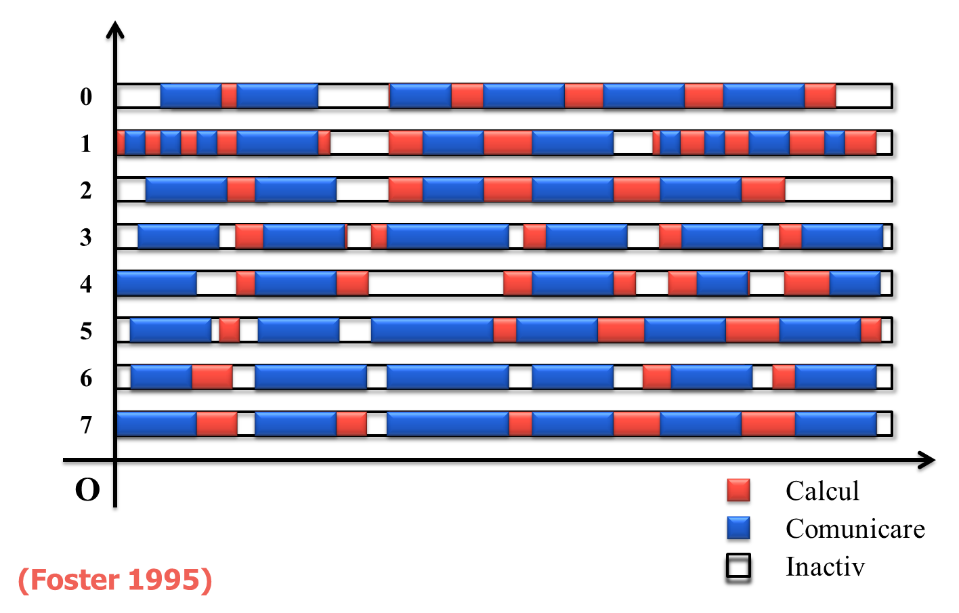
Foster model

Slide 55
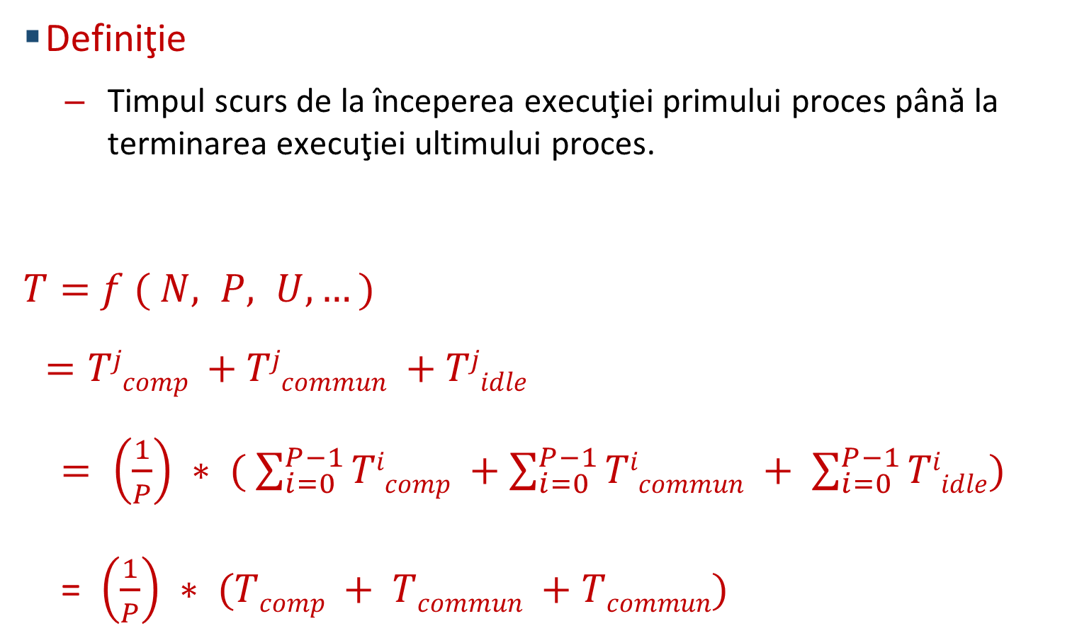
Foster model
Definiţie
Timpul scurs de la începerea execuţiei primului proces până la terminarea execuţiei ultimului proces.
$T=$ $f ( N, P, U, …)$
$=Tjcomp +Tjcommun +Tjidle$
$= \left(\frac{1}{P}\right) ∗ ( \sum_{i=0}^{P−1}{Ticomp} +\sum_{i=0}^{P−1}{Ticommun} + \sum_{i=0}^{P−1}{Tiidle})$
= $\left(\frac{1}{P}\right) ∗ (Tcomp + Tcommun +Tcommun)$

Slide 56
LogP model
P
M
P
M
P
M
overhead o
gap g
overhead o
Reţea de interconectare
latency L
L - latency sau întârzierea de transmitere a unui mesaj mic de la sursă la destinatar
o - overhead, durata pentru care procesorul este angajat în transmiterea sau recepţia fiecărui mesaj
g - gap, intervalul minim de timp între două transmiteri succesive sau două recepţii succesive la acelaşi modul
P - numărul de module procesor / memorie.

